Slide 1
Deep Culture Podcast
Episode 15 - Rubber time or Slaves to the Clock Expansion Activities
Open source teaching materials to be used with the Deep Culture podcast
Notes:
Use the podcast episode number and title.

Slide 2
Acknowledgements
These materials were created as part of a collaborative project by the Japan Intercultural Institute. They are open source and can be freely used. Special thanks to a dedicated team of educators from different countries that contributed to this project. Contributors include: Sanne Bosma, Tannistha Dasgupta, Meena Eswaran, Jane Everett, Rob Fritz, Grazia Ghellini, Katarzyna Grzesik-Harz, Valerie Hansford, Jessica Janda, Christina Kapaun, Corazon Kato, Kasia Kucharska, Isabelle Al-Haj Johnston, Zeina Matar, Lynne Murphy, Lucile Roberts, Jo Thomas, Marie Tseng, and Revathi Viswanathan.
To find out more about the project, see here. For questions, comments or participating in JII activities, contact: info@japanintercultural.org.

Slide 3
Expansion Activities
Notes:
In this section, educators can add any expansion activity using supplemental materials. This can elaborate on ideas from the podcast, or connect it to other ideas in society, learners’ lives, etc. When possible, include clear instructions and whatever supplemental materials that are necessary. It can also include ideas for possible extension activities to be developed by the educator.
TEACHING NOTES

Slide 4
Index Page Expansion Activties
Digging Deeper – Time Expressions
Digging Deeper – Monochronic Time
Digging Deeper – Polychronic Time
Expansion (1) - “The Gentlemen”
Expansion (2) - “Outsourced”
Expansion (3) - Image of time
Expansion (4) – Time in German Proverbs
Expansion (5) – How did your Grandparents ”mange” time?

Slide 5
Digging deeper (1) – Time expressions
一期一会
"Ichigo Ichie" - "making the most of every moment” is a Japanese proverb which can be translated in many ways. It means "one time, one meeting", but can also be translated as "one lifetime, one encounter“ or "in this moment, an opportunity". It reflects the importance the Japanese attach to the present and to mindfulness.
The Roman God of Beginnings and Time, Janus, was represented as a two-faced man, with one face looking ahead and one looking behind. This reveals how Future, Present and Past were equally important to the ancient Romans.
Questions:
Share some time expressions you know.
How do these expressions reflect your relationship with time?
How do different feeling about time influence our lives?
Sonia Payes, Woman in Bronze, 2024
Source: Grazia Ghellini
Notes:
Find key ideas or quote that can encourage learners to reflect and share their experiences. This can include exploring the implications of the theme. Discussion questions should be open ended and encourage learners to contribute their own ideas.
TEACHING NOTES
Let the students answer the questions on the slide.

Slide 6
Digging deeper (2): Monochronic time
Monochronic time refers to a cultural approach where time is perceived as linear, segmented, and structured. It emphasizes punctuality, schedules, and completing tasks one at a time. The idea was first articulated by anthropologist Edward T. Hall in the 1950s, who contrasted monochronic and polychronic time orientations to highlight cultural differences in time perception and management.
The basic characteristics of monochronic time:
Time as Linear and Sequential: Monochronic cultures view time as a series of events in a sequential order, focusing on one task at a time.
Emphasis on Schedules and Punctuality: There is a strong emphasis on adhering to schedules, deadlines, and punctuality
Task-oriented Focus: Individuals in monochronic societies prioritize tasks and objectives, often valuing productivity and efficiency.
Source: Gerd Altman,
https://pixabay.com/de/vectors/uhr-zeit-getriebe-zahnr%C3%A4der-7484249/
Question:
What are some advantages of a monochronic approach to time?
How do you feel when time is approached in this way?
Notes:
Key idea (introducing a key idea from the episode). Often the key idea can be described or defined using a quote from the episode.
TEACHING NOTES
Episode 15 team remark: In the podcast both time concepts are not clarified enough. The description of the monochronic concept has been included to complete the podcast.
Clarify to the students the monochronic concept of time as described on the slide.

Slide 7
Digging deeper (3): Polychronic time
Polychronic time refers to a cultural preference for multitasking and a flexible approach to scheduling, where multiple activities occur simultaneously. The terms was coined by anthropologist Edward T. Hall, in a contrast with monochronic time, where tasks are performed one at a time in a linear sequence.
The basic characteristics of the polychronic approach to time:
Flexible Scheduling: Schedules are seen as flexible and adaptable to changes.
Multi-tasking: People often engage in multiple tasks simultaneously.
Relationship-oriented: Emphasis on maintaining relationships over strict adherence to schedules.
Question:
What are some advantages of a polychronic approach to time?
How do you feel when time is approached in this way?
Source: Serena Wong
https://pixabay.com/de/illustrations/mann-b%C3%BCro-gesch%C3%A4ftsmann-gesch%C3%A4ft-1633667/
Notes:
Key idea (introducing a key idea from the episode). Often the key idea can be described or defined using a quote from the episode.
TEACHING NOTES
Episode 15 team remark: In the podcast both time concepts are not clarified enough. The description of the polychronic concept has been included to complete the podcast.
Clarify to the students the polychronic concept of time as described on the slide.

Slide 8
Expansion (1) - “The Gentlemen”
Watch the following excerpts from “The Gentlemen” episode 5 “I have hundreds of cousins” (Netflix).
Start watching from 31’40 sec. to 33’53 sec.
What do these scenes reveal about the Belgian character’s perception of British and “European” people’s attitudes to time ? How do they contrast according to him ?
Which character’s attitude to time reflects your own perception of how time should be handled ?
Notes:
Expansion activities: This slide or slides can be used for any optional activities or supplemental materials (images, links, related readings) that educators can use in creating their lesson.
TEACHING NOTES
Let the students watching the films excerpts and answer the questions on the slide

Slide 9
Expansion (2) - “Outsourced”
Do you think that our time-related patterns of behaviour can evolve over time? Discuss in pairs providing some anecdotes.
Watch the movie Outsourced available on Youtube.
Outsourced
What different attitudes to time does the movie show ?
How does the main character’s attitude to time evolve as a result of his work assignment in India?
Have you ever had a similar experience, which changed either your perception of time or your attitude towards time ?
Notes:
Expansion activities: This slide or slides can be used for any optional activities or supplemental materials (images, links, related readings) that educators can use in creating their lesson.
TEACHING NOTES
Let the students discuss the questions on the slide

Slide 10
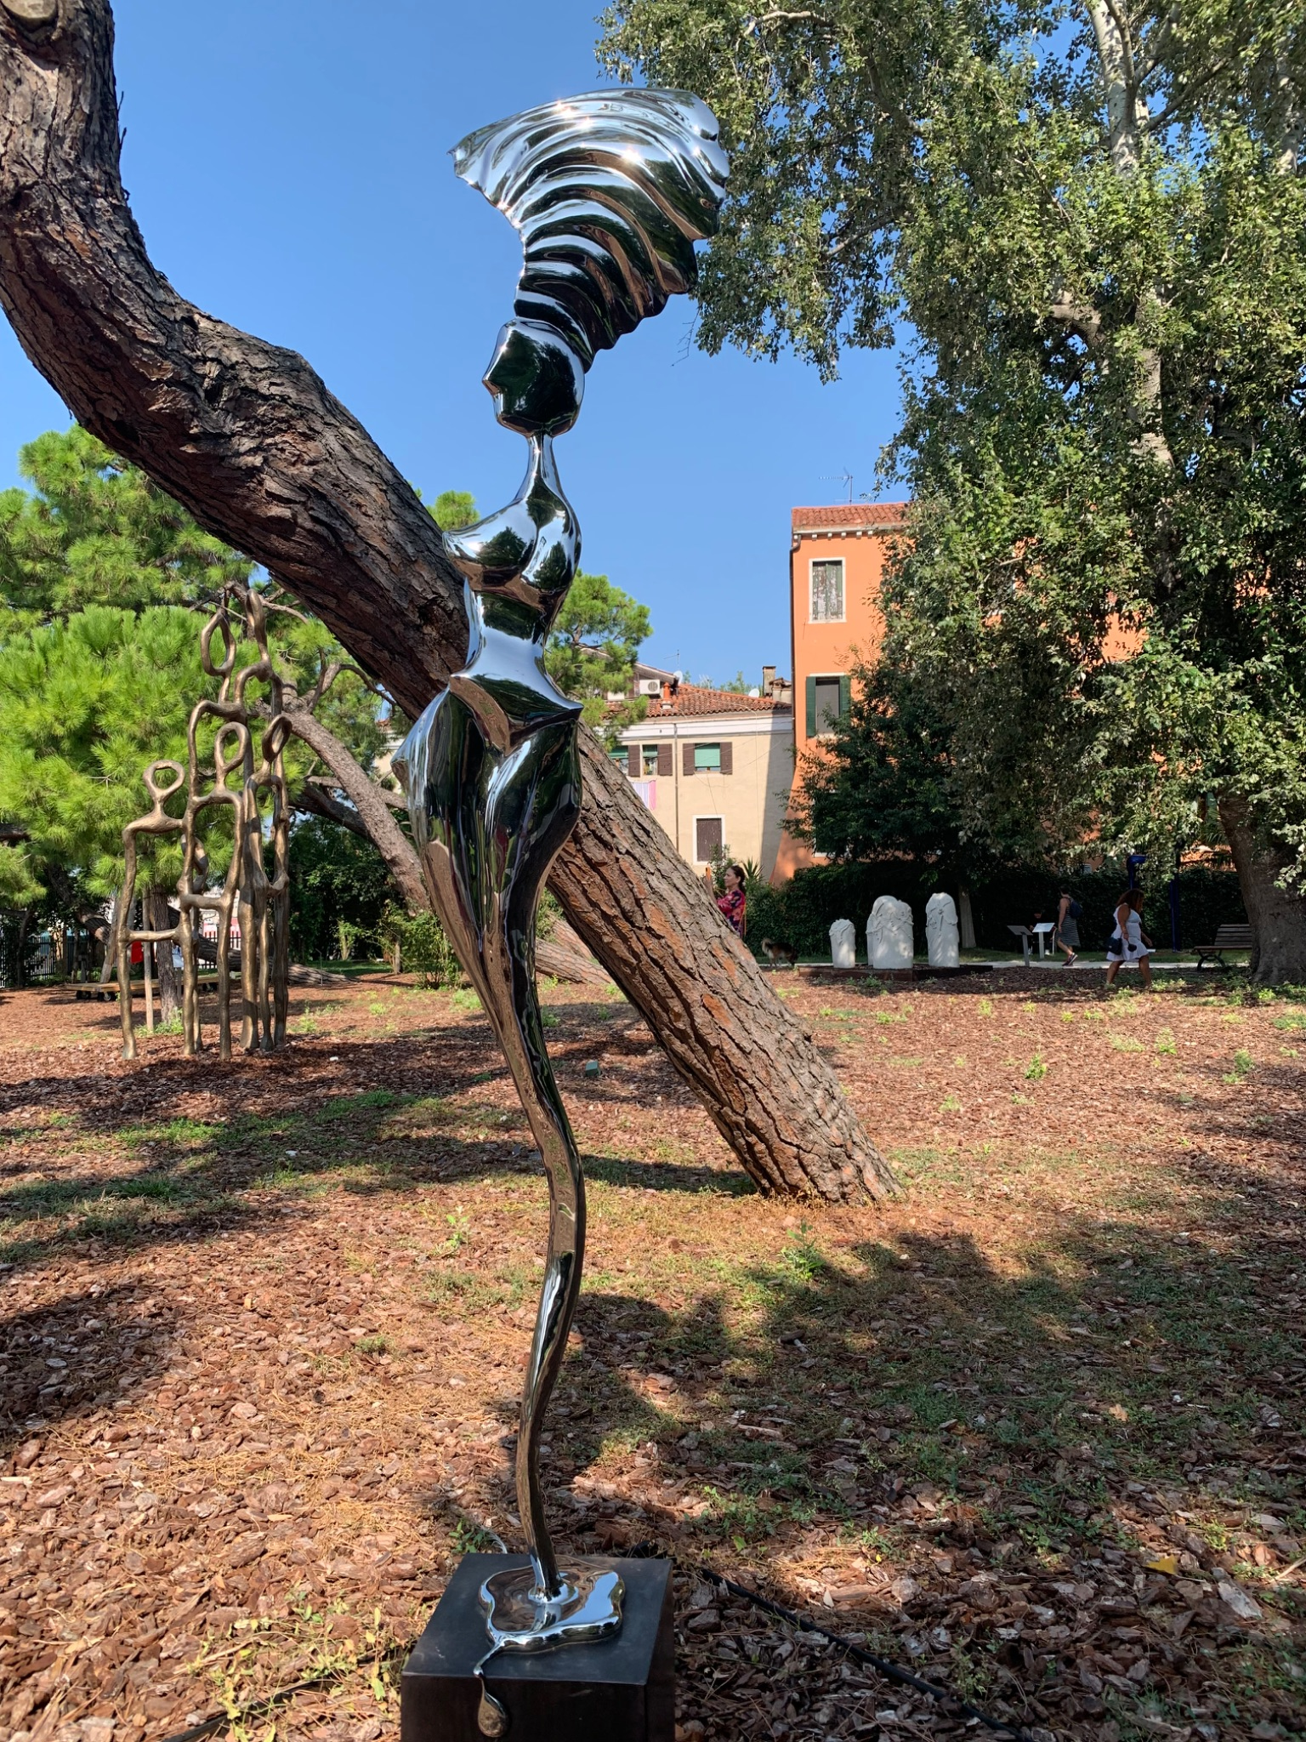
Expansion (3) - Image of time
Find an image - a work of art or a photo which illustrates your attitude to time. If you can’t find one you can draw it.
In pairs or small groups share your image with the others. Share personal anecdotes to explain why you have chosen that particular image.
Hugh McLachlan, Muse of Time (2004)
Source: Grazia Ghellini
Notes:
Expansion activities: This slide or slides can be used for any optional activities or supplemental materials (images, links, related readings) that educators can use in creating their lesson.
TEACHING NOTES
Ask the students to follow the instructions on the slide
Find an image - a work of art or a photo which illustrates your attitude to time. If you can’t find one you can draw it.
In pairs or small groups share your image with the others. Share personal anecdotes too to explain why you have chosen that particular image

Slide 11
Expansion (4) – Time in German Proverbs
Discuss in pairs the following German proverbs about time. What do they reveal about German patterns of behaviour related to time around time?
1. **"Zeit ist Geld."**
**Translation:** "Time is money."
2. **"Zeit heilt alle Wunden."**
**Translation:** "Time heals all wounds."
3. **"Die Zeit vergeht wie im Flug."**
**Translation:** "Time flies."
4. **"Jede Zeit hat ihre Pflicht."**
**Translation:** "Every time has its duty."
5. **"Mit der Zeit kommt Rat."**
**Translation:** "With time comes advice."
6. **"Alles hat seine Zeit."**
**Translation:** "Everything has its time."
7. **"Morgenstund hat Gold im Mund."**
**Translation:** "The early bird catches the worm." (Literally: "Morning hour has gold in its mouth.")
8. **"Zeit ist das, was man an der Uhr abliest."**
**Translation:** "Time is what you read on the clock."
9. **"Wer die Zeit nicht nutzt, den bestraft sie."**
**Translation:** "He who does not use time, will be punished by it."
10. **"In der Kürze liegt die Würze."**
**Translation:** "Brevity is the soul of wit."
(Literally: "In the brevity lies the spice.")
Notes:
Expansion activities: This slide or slides can be used for any optional activities or supplemental materials (images, links, related readings) that educators can use in creating their lesson.
TEACHING NOTES
Ask the students to discuss in pairs the following German proverbs about time. What do they reveal about German patterns of behaviour related to time around time?
Why do they think so?
Then, let them share for the whole group.
Answer: These quotes highlight various perceptions of time, emphasizing its value, its healing nature, its fleeting quality, and the importance of making good use of it.
Comment for educators / trainers:
Answers may vary
The German proverbs can be replaced by proverbs from any other culture. The answers must be adjusted accordingly.
You may have to explain the expression “cultural patterns” if it is not familiar to the students.

Slide 12
Expansion (5) – How did your grandparents ”manage” time?
Think about your parents and grandparents. What is your perception of how they handle time? Is it similar to you or is it different?
For example, how long do you wait before responding to a text or email? Is it the same or different for how long they take before responding?
How has the way we think about making appointments changed over time?
Notes:
Expansion activities: This slide or slides can be used for any optional activities or supplemental materials (images, links, related readings) that educators can use in creating their lesson.
TEACHING NOTES

Slide 13
Teaching Tips
A personal note to the educators about what to keep in mind when using this lesson . . . for example, possible ideas for expansion activities, strengths of this lesson, points to be careful about (e.g. learner reactions to certain ideas, things that can easily be misunderstood)
Points to be careful about:
There can be a tendency for students to make general statements like “Germans are monochronic”. Remember that time use is also personal and situational. What’s important is to understand the different time logics.
To help students think about how they relate to time, have students think about and discuss their reaction to missing a scheduled train/ bus etc. and have to take another one in a few minutes (See ‘Digging Deeper’ section in the Powerpoint set). Do they think they have “lost time” or are they relaxed and think they have gained time?
If using case studies based on time difference conflicts/misunderstandings, be sure to use situations to which participants can relate/connect and try to avoid using nationality descriptions for each character in the case studies to reduce the possibility of stereotyping by participants and to encourage the idea of individual time differences.
Notes:
A personal note to the educators about how what to keep in mind when using this lesson . . . for example, possible ideas for expansion activities, strengths of this lesson, points to be careful about (e.g. learner reactions to certain ideas, things that can easily be misunderstood)
TEACHING NOTES

Slide 14
Deep Culture Podcast
Episode 15 - Rubber time or Slaves to the Clock Expansion Activities
Open source teaching materials to be used with the Deep Culture podcast
Notes:
Use the podcast episode number and title.

