Slide 1

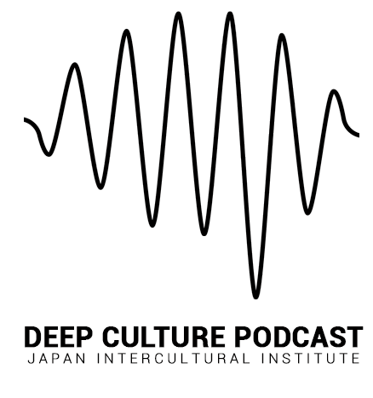
Deep Culture Podcast
Episode 30 - Ethnocentrism
Open source teaching materials to be used with the Deep Culture podcast

Slide 2

Acknowledgements
These materials were created as part of a collaborative project by the Japan Intercultural Institute. They are open source and can be freely used. Special thanks to a dedicated team of educators from different countries that contributed to this project. Contributors include: Sanne Bosma, Tannistha Dasgupta, Meena Eswaran, Jane Everett, Rob Fritz, Grazia Ghellini, Katarzyna Grzesik-Harz, Valerie Hansford, Jessica Janda, Christina Kapaun, Corazon Kato, Kasia Kucharska, Isabelle Al-Haj Johnston, Zeina Matar, Lynne Murphy, Lucile Roberts, Jo Thomas, Marie Tseng, and Revathi Viswanathan.
To find out more about the project, see here. For questions, comments or participating in JII activities, contact: info@japanintercultural.org.

Slide 3
Module Structure
Episode Overview: Summary, link, key themes
Opening Discussion: Are you ethnocentric?
Part 1: Reporting the Facts - Key ideas / insights
Part 2: Naturally Ethnocentric - Key ideas / insights
Part 3: Paradigm Shift - Deeper Understanding
Digging Deeper

Slide 4
Episode Overview

Slide 5
Episode summary
Is ethnocentrism learned from our environment? Is it a natural part of how our mind works? Many intercultural educators believe that ethnocentrism is learned . . . but is this true? In this month’s Deep Culture Podcast, Emre Seven and Joseph Shaules explore what brain and mind sciences can tell us about ethnocentrism. We hear about caste labeling from Ishita Ray, and Daniel Glinz tells us how language learning can expand our cultural self.
Notes:
Episode summary (brief overall description) can be found on JII website or on podcast platforms.

Slide 6
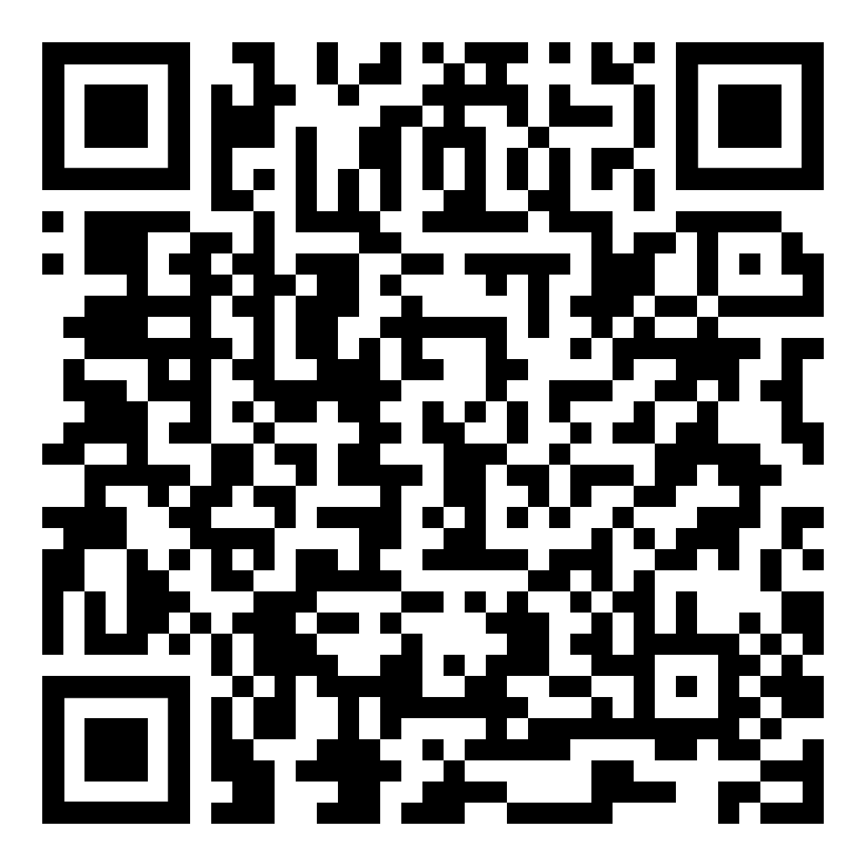
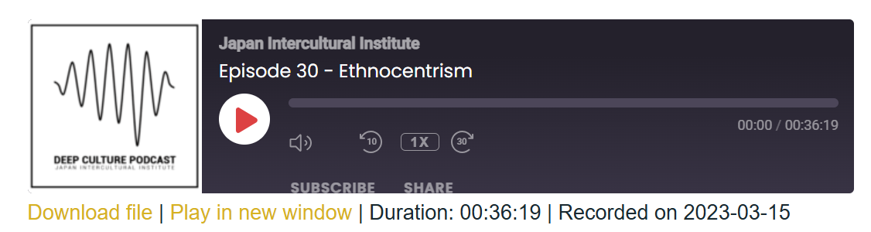
Listen to the episode: https://japanintercultural.org/podcast/episode-30-ethnocentrism/
Read the transcript: https://japanintercultural.org/wp-content/uploads/2023/05/S03E30_Ethnocentrism_Transcript.pdf
Notes:
Link to episode, podcast graphic (from JII website), QR code that links to episode, link to transcript

Slide 7
Key themes
Listen for the following themes:
Part 1: Reporting the Facts
Part 2: Naturally Ethnocentric
Part 3: The Paradigm Shift
Notes:
Key themes (Themes corresponding to the three parts of the podcast. Use the part titles) This gives listeners an idea of the overall structure of the podcast and the themes they can expect to learn about.

Slide 8
Opening Discussion:
Are you ethnocentric?
Notes:
This section introduces the core theme of the episode. It provides educators a way to introduce the overall theme (e.g. active learner schema).

Slide 9
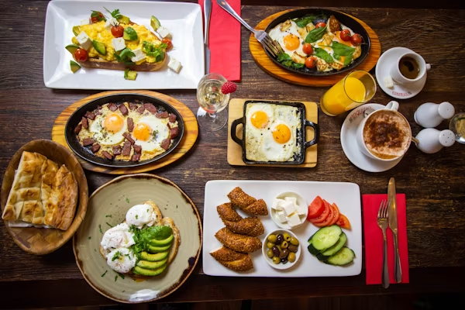
Opening Discussion
(06:46)
I remember years ago I noticed my own ethnocentrism at breakfast when I was traveling in France.[...] (6:57) The tour guide had mentioned that there was a buffet breakfast, which I was really excited about. But when I approached the table, I see there is only croissant, coffee and cheese. And I thought, is that all? Man, that's no buffet!
(Image source: https://unsplash.com/photos/a-table-full-of-food-P_Qf5AHqLh8 )
Notes:
Exploring key ideas involves giving more information about the key idea in order to have a more complex/deeper understanding of the idea. These questions get learners to think about the ideas. Can use an audio clip or quote from the episode that elaborates on the key idea. The goal is to get learners thinking more deeply about the key idea.

Slide 10
Quick Understanding
What was served for breakfast when Emre visited France?
What was Emre’s reaction when he saw the breakfast buffet? Why?
Notes:
Comprehension questions related to opening discussion content . . .
Answer key to questions:

Slide 11
Share your thoughts . . .
1. What image comes to your mind when you think of breakfast? What breakfast foods from other cultural that are not typical for you?
3. Have you had a negative impression about foreign things? What happened? How did you feel?
4. Have you experienced anyone else make a negative judgement about your culture? What happened? How did you feel?
Notes:
Discussion question related to opening discussion

Slide 12
Part 1: Reporting the facts
Key ideas / insights
Notes:
The module follows the flow of the podcast, with key ideas or insights for each of the three parts. “Key ideas” refers to the concepts that need to be understood or remembered, whereas “insights” refers to the deeper understanding of the ideas (e.g. how they relate to everyday life). Identifying the key ideas and key insights for each episode is an important step in creating the materials. It is recommended to identify 1 - 3 key ideas/ insights from each part. In general, each part of the podcast has a main theme which can be understood by looking for the title of each part.

Slide 13
Key idea: What is ethnocentrism?
(4:55)
Joseph: Merriam Webster defines ethnocentrism as the attitude that one's own group ethnicity or nationality is superior to others.
***
(6:26) Emre: And that is ethnocentrism, looking at things through the familiar lens of our previous experience and cultural worldview.
Notes:
Key idea (introducing a key idea from the episode). Often the key idea can be described or defined using a quote from the episode.

Slide 14
Exploring key idea: What is ethnocentrism?
(08:10) Joseph: So, from the anthropological point of view, this is at the core of ethnocentrism - the feeling that what is familiar to me is normal and anything else is somehow wrong or not up to standard. It has also been defined as a bias or tunnel vision in which “an individual views the world from the perspective of his or own group, establishing the in-group as archetypal and rating all other groups with reference to this ideal”.
What is ethnocentrism from an anthropological point of view?
Why is ethnocentrism also referred to as “tunnel vision”?
Notes:
Exploring key ideas involves giving more information about the key idea in order to have a more complex/deeper understanding of the idea. These questions get learners to think about the ideas. Can use an audio clip or quote from the episode that elaborates on the key idea. The goal is to get learners thinking more deeply about the key idea.

Slide 15
Check your understanding!
Which of the following is true about ethnocentrism?
What is familiar to me feels right
Familiar things feel boring to me
I dislike things that feel normal
Notes:
Correct answer: (a) What is familiar to me feels normal.
Answer key to questions:

Slide 16
Key insight: Ethnocentrism feels like reporting facts
(9:59)
Joseph: Somehow when we are making ethnocentric judgments, we feel like we are just reporting the facts. But often there's a negative value judgment involved.
Notes:
Key idea (introducing a key idea from the episode). Often the key idea can be described or defined using a quote from the episode.

Slide 17
Exploring key insight: Reporting the facts
(9:59) Joseph: One odd thing about ethnocentrism is how invisible it often is. Somehow when we are making ethnocentric judgments, we feel like we are just reporting the facts. But often there's a negative value judgment involved. [...]
(10:21) Emre: Yes, but I also have seen something else. We sometimes make ethnocentric judgments against our own society or community.
***
(10:44) Joseph: Ethnocentrism is grounded most fundamentally in the unconscious assumption that there is a single standard by which things are judged.
Emre: If there's a single standard of right or normal, you don't recognize that your perceptions depend on your previous experience.
Why does it mean to say ethnocentrism is invisible to us?
Why don’t we recognize that we are judging from our previous experience?
Notes:
Exploring key ideas involves giving more information about the key idea in order to have a more complex/deeper understanding of the idea. These questions get learners to think about the ideas. Can use an audio clip or quote from the episode that elaborates on the key idea. The goal is to get learners thinking more deeply about the key idea.

Slide 18
Check your understanding!
Ethnocentrism can feel like reporting the facts because:
It has a negative value judgement
It is an unconscious judgement
It is always against other groups
Notes:
Correct answer: (b) It is an unconscious judgement

Slide 19
Check your understanding!
What is the unconscious assumption behind ethnocentrism?
That no one knows everything
That we need to respect others’ opinions
That there is a single standard to judge by
Notes:
Correct answer: (b) It is an unconscious judgement

Slide 20
Part 2: Naturally Ethnocentric
Key ideas / insights

Slide 21
Key insight: Ethnocentrism is natural
(12:14)
And ethnocentric reactions are a natural result of predictive processing because our expectations about how the world works or how it should work come from our previous experience.

Slide 22
Exploring key insight: Ethnocentrism is natural
(11:49)
Joseph: Our mind navigates the world using internal models. We're constantly making unconscious predictions about what we experience. And the world is often a predictable place. So when you flip the switch, the light comes on, it's all automatic.
Emre: If every time we saw a light switch, we had to think about turning on the light, we would constantly be overwhelmed.
Joseph: So instead, we're constantly anticipating what will happen next. And ethnocentric reactions are a natural result of predictive processing because our expectations about how the world works or how it should work come from our previous experience.
What is predictive processing? How is it useful?
How is predictive processing a starting point for ethnocentrism?
Notes:
Exploring key ideas involves giving more information about the key idea in order to have a more complex/deeper understanding of the idea. These questions get learners to think about the ideas. Can use an audio clip or quote from the episode that elaborates on the key idea. The goal is to get learners thinking more deeply about the key idea.

Slide 23
Check your understanding!
How does predictive processing help us navigate in the world?
It helps us think carefully about what will happen next
It helps us forget our previous experiences
It helps us make quick predictions in an unpredictable world
Notes:
Correct answer: (c) It helps us make quick predictions in an unpredictable world.

Slide 24
Check your understanding!
Why is ethnocentrism “natural”?
Because it’s a result of predictive processing
Because it’s natural for us to feel overwhelmed
Because we often are unsure what to do
Notes:
Correct answer: (a) Because it’s a result of predictive processing

Slide 25
Key insight: Ethnocentrism is a collective survival mechanism
(16:46)
The fact is ethnocentrism often feels good. It gives a sense of security and solidarity in a hostile world filled with “others”.
Notes:
Key idea (introducing a key idea from the episode). Often the key idea can be described or defined using a quote from the episode.

Slide 26
Exploring key idea: Ethnocentrism is a collective survival mechanism
(16:46) And yet ethnocentrism is natural, a collective survival mechanism. It is the glue that holds communities together. [...] The fact is ethnocentrism often feels good. It gives a sense of security and solidarity in a hostile world filled with “others”. I for example, grew up surrounded by the idea that I have a right to condescend the language of my neighbors. [...] (18:09) That’s the idea that my language is the standard was reinforced then casually invalidating other languages, we were invalidating the lived experiences of the people of those communities. And because our ethnocentric instinct is primordial, so visceral, it becomes a breeding ground for prejudice.
How does ethnocentrism act as a “collective survival mechanism”?
How does ethnocentrism become a “breeding ground for prejudice”? Explain or illustrate with an example from the clip.

Slide 27
Check your understanding!
How does ethnocentrism act as a “collective survival mechanism”?
It creates solidarity with other communities
It gives a sense of security in a hostile world
It creates good relationships with people we don’t know
Notes:
Correct answer: (b) It gives a sense of security in a hostile world

Slide 28
Part 3: The Paradigm Shift
Deeper Understanding
Notes:
The module follows the flow of the podcast, with key ideas or insights for each of the three parts. Digging deeper explores part 3 of the podcast, which often deals with the psychology of the theme (an empirical understanding based on brain-mind science). It gives educators the option of going in to greater intellectual depth and detail.

Slide 29
Deeper understanding
Joseph: (23:10) We can learn to look at the world with new cultural glasses. It's possible to undergo a kind of paradigm shift. We experience a fundamental change to how we view the world.
Emre: And rather than judging things from one absolute standard, we learn to accept and respect that there are other ways of looking at things.
*****
Emre: (24:46) Well, one simple insight that has been powerful for me is that cultural learning is the process of pattern recognition.
Joseph: So when we're in a familiar environment, we can easily read the patterns around us. But in a foreign environment, our normal interpretive frameworks don't work. So how do we make sense of these new patterns?
Emre: And the ethnocentric answer is that we continue to use our existing interpretive schema. We judge new patterns based on our familiar standards.
Joseph: But it's also possible for us to somehow create a new, seemingly separate mental structure and alternative set of interpretive patterns.
Notes:
(The psychology behind the key ideas / insights with quotes from the episode. Refer to sample materials for ideas.) Deeper understanding provides more detailed information about key ideas. This section can make clearer the science behind the main ideas and insights.

Slide 30
Check your understanding
What is the “paradigm shift” that can happen because of cultural learning?
Using existing schema to interpret foreign experiences.
A fundamental change in how we see the world.
Using an absolute standard to make sense of things.
Notes:
Correct answer: (b) A fundamental change in how we see the world.

Slide 31
Check your understanding
How is cultural learning a form of “pattern recognition”?
Foreign patterns make us curious about cultural difference.
New cultural patterns stress us and prevent cultural learning.
We learn new cultural patterns to make sense of foreign experiences.
Notes:
Correct answer: c) We learn new cultural patterns to make sense of foreign experiences.

Slide 32
Check your understanding
What do we need to look at the world with new “cultural glasses”?
Create a different way of interpreting the things we experience.
Judge new patterns based on familiar standards.
Read the cultural patterns we are used to.
Notes:
Correct answer: (a) Create a different way of interpreting the things we experience.

Slide 33
Digging Deeper
Notes:
This section encourages learners to reflect and share their experiences. This can include exploring the implications of the theme.

Slide 34
Digging deeper:
(24:18) I remember a similar set of feelings when I returned from the US to Turkey. When I stepped in the airport in Istanbul, I felt like I was not the me who left from there four months ago, I came back as a new person with a new way of looking at the world.
Why does having a foreign experience change the way we see our home / familiar environment?
How have new/foreign experiences changed the way that you see the world?
In your experience, how can foreign experience help us grow as people?

Slide 35
Digging deeper:
(27:52) I was seven years old playing in the schoolyard with my friends. When I first heard it exclaimed that my family was from a certain caste. It caught me off guard. I had never heard it discussed at home. Why did others put me in a category that I didn't even know existed? It was deeply disturbing. I was angry.
When have you or others you know been judged in ethnocentric / judgmental ways? How did you feel/react? What is your advice for someone in this situation?

