Slide 1
Deep Culture Podcast
Episode 33 - Stereotypes
Open source teaching materials to be used with the Deep Culture podcast

Slide 2
Acknowledgements
These materials were created as part of a collaborative project by the Japan Intercultural Institute. They are open source and can be freely used. Special thanks to a dedicated team of educators from different countries that contributed to this project. Contributors include: Sanne Bosma, Tannistha Dasgupta, Meena Eswaran, Jane Everett, Rob Fritz, Grazia Ghellini, Katarzyna Grzesik-Harz, Valerie Hansford, Jessica Janda, Christina Kapaun, Corazon Kato, Kasia Kucharska, Isabelle Al-Haj Johnston, Zeina Matar, Lynne Murphy, Lucile Roberts, Jo Thomas, Marie Tseng, and Revathi Viswanathan.
To find out more about the project including the team of contributors, see here. For more information or any questions, contact: info@japanintercultural.org.

Slide 3
Module Structure
Introducing the episode: Summary, link, key themes
Opening Discussion: Stereotypes
Part 1: The Power of Stereotypes - Key ideas / insights
Part 2: Navigating Stereotypes - Key ideas / insights
Part 3: Cognitive Categories - Deeper Understanding
Digging Deeper
Notes:
Part 1: (part title) 1-3 key ideas/ insights from part 1 (Essential elements of each idea/ insight: Introducing the idea/ insight - exploring the idea/ insight - check your understanding)
Part 2: (Part title) 1-3 key ideas/ insights from part 1 (Essential elements of each idea/ insight: Introducing the idea/ insight - exploring the idea/ insight - check your understanding)
Part 3: (Part title) Deeper understanding (Essential elements: More information/ research into ideas/ inights - Check your understanding)
Digging Deeper (Reflection/ Experience sharing)
Expansion activities

Slide 4
Episode Overview

Slide 5
Episode summary
People say “Don’t stereotype!” But this is impossible because stereotypes are a natural part of our mental and social functioning. Join Joseph Shaules and Ishita Ray as they explore the cognitive complexity of stereotypes, including the difference between innocent and aggressive stereotypes—differentiation and otherizing. We also hear from Emre Seven, Daniel Glinz and Zeina Matar about the challenges and occasional pleasures faced by cultural bridge people navigating a world full of stereotypes.

Slide 6
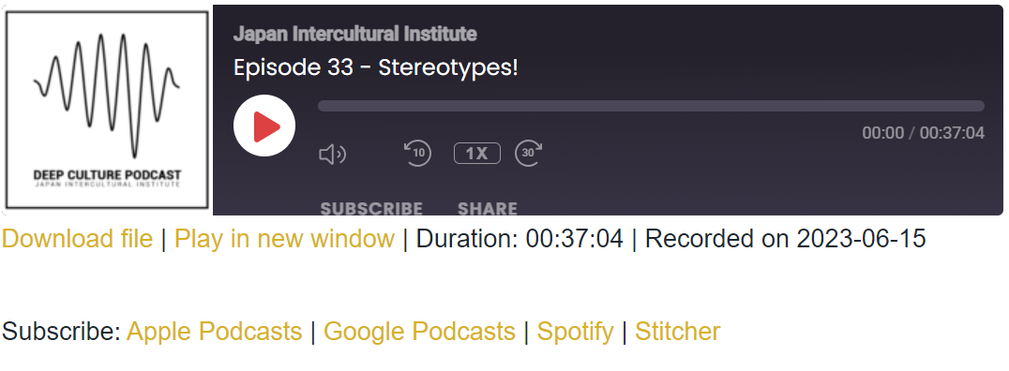
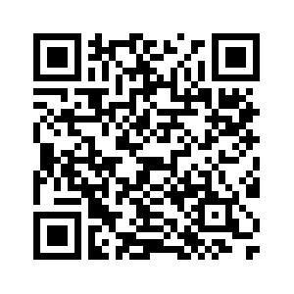
Listen to the episode: https://japanintercultural.org/podcast/episode-33-stereotypes/
Read the transcript: https://japanintercultural.org/wp-content/uploads/2023/08/S03E33_Stereotypes_Transcript.pdf
Notes:
Link to episode, podcast graphic (from JII website), QR code that links to episode, link to transcript

Slide 7
Key themes
Listen for the following themes:
Part 1: The Power of Stereotypes
Part 2: Navigating Stereotypes
Part 3: Cognitive Categories (of stereotypes)
Notes:
Key themes (Themes corresponding to the three parts of the podcast. Use the part titles) This gives listeners an idea of the overall structure of the podcast and the themes they can expect to learn about.

Slide 8
Opening Discussion: Stereotypes
Notes:
This section introduces the core theme of the episode. It provides educators a way to introduce the overall theme (e.g. active learner schema).

Slide 9
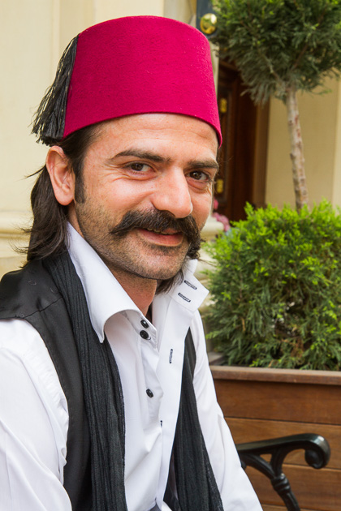
Opening Discussion:
(19.04) “I always face surprise from people from different countries because I do not look like the image of a Turk in their mind. First of all, my appearance, instead of having a dark, short hair, stubbly beard and moustache and wearing a suit, I have long hair that is light colored. I wear earrings and have a casual style. . . . I'm always having to work against the typical image of what it means to be a Turkish man.”
https://for91days.com/photos/Istanbul/Turkish%20Mustache/Turkish%20Mustachel%20-01%20130510%20Juergen%20Horn.JPG
Notes:
The goal is to activate learner schema and get learners thinking about the theme that will be discussed.

Slide 10
Quick Understanding
What are the typical images of a Turkish man described here?
In what ways is the speaker “different” from the stereotypical image?

Slide 11
Share your thoughts . . .
Can you think of a time when someone made a quick judgement about you? What happened? Was their impression accurate? Why/ why not?
Have you ever made a quick judgement about someone? What happened? Was your impression accurate? Why/ why not?

Slide 12
Part 1: The Power of Stereotypes
Key ideas / insights

Slide 13
Key idea: What are stereotypes?
Stereotype: a simplified idea about what is typical for a personal group (04.02)
It comes from the French “stéréotype” and refers to a printing method using solid plates. So, from this we get the idea of a stereotype being a fixed image. [...] And these images can be prejudicial. (03.44)

Slide 14
Exploring key idea: What are stereotypes?
“And so stereotypes become a kind of shared currency, a set of images that people used to talk about difference. Why do our minds work this way? What evolutionary purpose might they serve?
And what we find is that there is a certain cognitive efficiency in stereotypes. Our ancestors survived by quickly judging people. Friend? Enemy? Are they nice? mean? We categorized people by quickly accessing salient information.
And this is efficient in the sense that these images come quickly to mind and allow us to make quick judgements.” (06.05)
What is the ‘evolutionary purpose’ of stereotypes?
How did it help our ancestors to make quick judgements?

Slide 15
Check your understanding!
What are stereotypes?
They are mental shortcuts that helped our ancestors get through our daily lives
They are images our minds form as part of conscious thinking over time
They are prejudices we carry about people we understand well
Notes:
Correct answer: (a) They are mental shortcuts that helped our ancestors get through our daily lives

Slide 16
Key insight: Stereotypes are natural!
“Stereotypes are a natural part of how our minds work.” (1.31)
How are stereotypes “natural”?
Does this mean that they are “good”? Why? Why not?

Slide 17
Exploring key insight: Stereotypes are natural
“Stereotypes are a natural part of how our minds work.
Which doesn't mean that stereotypes are good or that we don't have to be careful about them, but the fact is they are unavoidable.
Because if you are face-to-face with someone whose cultural background, you know little about, then the first things that will come to mind will naturally be stereotypes.
And if they know little about your cultural background, then their mind will be full of stereotypes and they will often treat you in this simplistic way.” (1.31)
If stereotypes are a natural reaction to those we understand little about, what implications could it have when we encounter cultural difference?
Notes:
Exploring key insights involves having a deeper reflection, or a more complex/deeper understanding of the insight. The goal is to get learners thinking more deeply about the key insight.

Slide 18
Check your understanding!
Which of the following is true about stereotypes:
They are a natural part of how our minds work so there is nothing wrong with them
They are a natural part of how our minds work, but that doesn’t mean that they are good
They are a natural part of how our minds work and so they are easily avoidable
Notes:
Correct answer: (b) They are a natural part of how our minds work, but that doesn’t mean that they are good

Slide 19
Key insight: Innocent vs aggressive stereotypes
“Innocent stereotypes involve differentiation. Whereas aggressive stereotypes involve otherizing.” (10.37)
How can stereotypes be innocent or aggressive?
What is the difference between differentiation and otherizing?

Slide 20
Exploring key insight: Innocent vs aggressive stereotypes
Differentiation refers to this process of categorizing, defining how people are similar or different. And the more we learn, the more complex our categories are. (10.50)
Otherizing on the other hand, refers to stereotyping whose primary purpose is to draw a line between you and me - or between different groups to mark you as distinct and perhaps even inferior.” (11.22)
Can you think of stereotypes that are used to differentiate and otherize?
What happens when stereotypes are used to differentiate? (Dig deeper: Is differentiating always positive?)
What could be the impact when stereotypes are used to otherize?

Slide 21
Check your understanding!
Which of these is an example of otherising?
“Oh Elbonians are lazy. You cannot trust them!”
“Oh you’re a Californian? Do you surf?”
“Do Swiss people whistle?”
Notes:
Correct answer: (a) “Oh Elbonians are lazy. You cannot trust them!”

Slide 22
Check your understanding!
Which of these is an example of differentiation?
“Oh Elbonians are lazy. You cannot trust them!”
“Oh you’re a Californian? Do you surf?”
“The management team is a bunch of jerks!”
Notes:
Correct answer: (b) “Oh you’re a Californian? Do you surf?”

Slide 23
Part 2: Navigating Stereotypes
Key ideas / insights

Slide 24
Key insight: Stereotypes are a fork in the road
“Dealing with stereotypes often involves a kind of fork in the road. Stereotypes can be a point of departure for learning more, but they can also be a roadblock.” (13.49)
What is a “fork in the road”?
What does it mean that stereotypes can be “a fork in the road”?

Slide 25
Exploring key insight: Stereotypes are a fork in the road
“Dealing with stereotypes often involves a kind of fork in the road. Stereotypes can be a point of departure for learning more, but they can also be a roadblock.
It's as though stereotypical thinking puts you in a mental box. And depending on how you react, you can try to get out of that box, or you can get locked into that box.” (13.49)
How can stereotypes to be roadblocks to cultural learning?
How can stereotypes are a starting point for cultural learning?
How can our reactions to stereotypes make a difference?

Slide 26
Check your understanding!
Which of the following is true about navigating stereotypes:
Stereotypes can be a starting point or a barrier to cultural learning
Some people never use stereotypes
Stereotypes are wrong and therefore we must avoid them
Notes:
Correct answer: (a) Stereotypes can be a starting point or a barrier to cultural learning

Slide 27
Part 3: Cognitive Categories
Deeper Understanding

Slide 28
Deeper understanding
Confirmation bias: Our mind's natural tendency to seek out information that supports what we already believe. (28.03) Sometimes the confirmation bias reinforces negative stereotypes. And this gives birth to prejudice. (29.17)
Dunning-Kruger effect: There's an inverse relationship between our level of knowledge and the confidence we feel in our judgments. In other words, the less we know, the more confidence we have. (30.17)
Fundamental Attribution Error: our tendency to explain the behavior of others by assuming some essential inner quality, whereas we judge our own behavior relative to the environment. (31.04)
Implicit Bias: a negative attitude that we aren't consciously aware of, a result of having learned negative associations. (31.53)

Slide 29
Check your understanding
So, if the person we are supposed to interview for a new job is late, we think, “Oh, they must be irresponsible.” But if I am late, I think about how the heavy traffic made me late.
This is an example of:
Confirmation bias
The Dunning-Kruger effect
Fundamental Attribution Error
Notes:
Correct answer: c) Fundamental Attribution Error

Slide 30
Check your understanding
If you have grown up hearing that Elbonians are lazy and you travel to Elbonia and see a group of people standing and chatting around the corner, you might say: “Oh, look at those lazy Elbonians standing around doing nothing.”
This is an example of:
Confirmation bias
The Dunning-Kruger effect
Fundamental Attribution Error
Notes:
Correct answer: (a) Confirmation bias

Slide 31
Digging Deeper

Slide 32
Digging deeper:
“From the cognitive perspective, stereotypes are our mind's reaction to something foreign about which we only have limited understanding.” (27.15)
What does this mean in the light of intercultural experiences?
How did our minds learn to react to “something foreign about which we only have limited understanding”?
How easy/ difficult do you think it is difficult to avoid stereotypes? Why?

Slide 33
Digging deeper:
“If people have only a simple category to think about you, then in some sense you're being treated like an object. You are not a fully individualized human being.” (16.17)
How does stereotyping reduce people into a simple category? Share examples, reactions, how people can feel or react.
How can simple categorising come in the way of seeing someone as an ‘individualised human being’?
How can this affect how we react to those that are different to us?

Slide 34
Digging deeper:
“Dealing with stereotypes often involves a kind of fork in the road. Stereotypes can be a point of departure for learning more, but they can also be a roadblock.” (13.49)
Think about the stereotypes you have faced or have used. Discuss as a class how the examples shared could be a roadblock or a departure for cultural learning?

